Slide 1
Advanced Control Strategies
Lec-11
Instrumentation and Process Control – ChE-323

Slide 2
Beyond single loop systems
Single loop systems
  One controller
  One measuring element
Types of multiloop systems
  Cascade control
  Feedforward control
  Ratio control
  Smith predictor control
  Internal model control

Slide 3
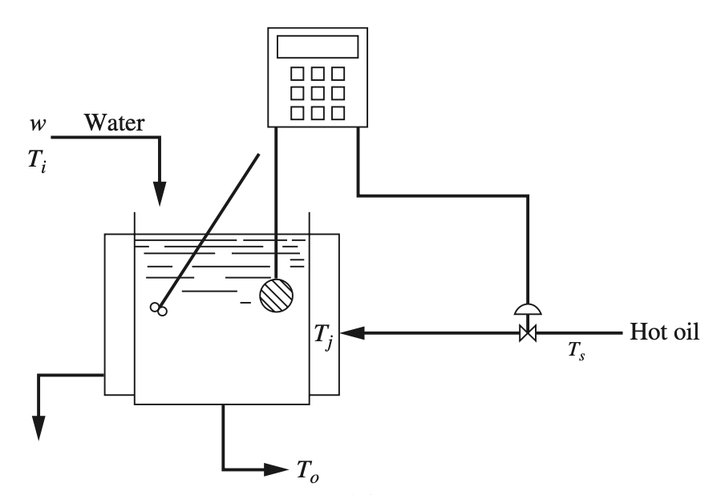
Cascade Control
Jacketed kettle – single loop control
Water heated with hot oil in the jacket
Measurement of water temperature is basis for control of oil flowrate
In case oil temperature falls, the system experiences prolonged offset from the set point
Single loop control of Jacketed kettle

Slide 4
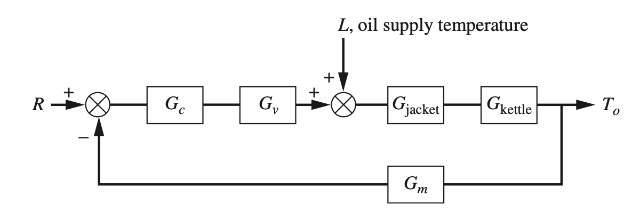
Cascade Control
Jacketed kettle – single loop control
Single loop control of Jacketed kettle – Block diagram

Slide 5
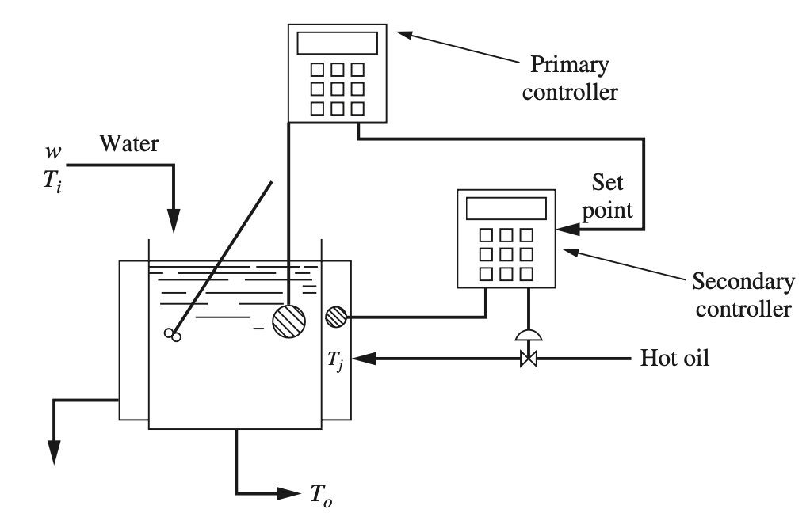
Cascade Control
Jacketed kettle – cascade control
To avoid slow response to changes in oil temperature two controllers and two measuring elements are used.
The primary controller is able to set the jacket temperature – indirectly
Primary controller – master controller
Secondary controller – slave controller
Cascade control of Jacketed kettle

Slide 6
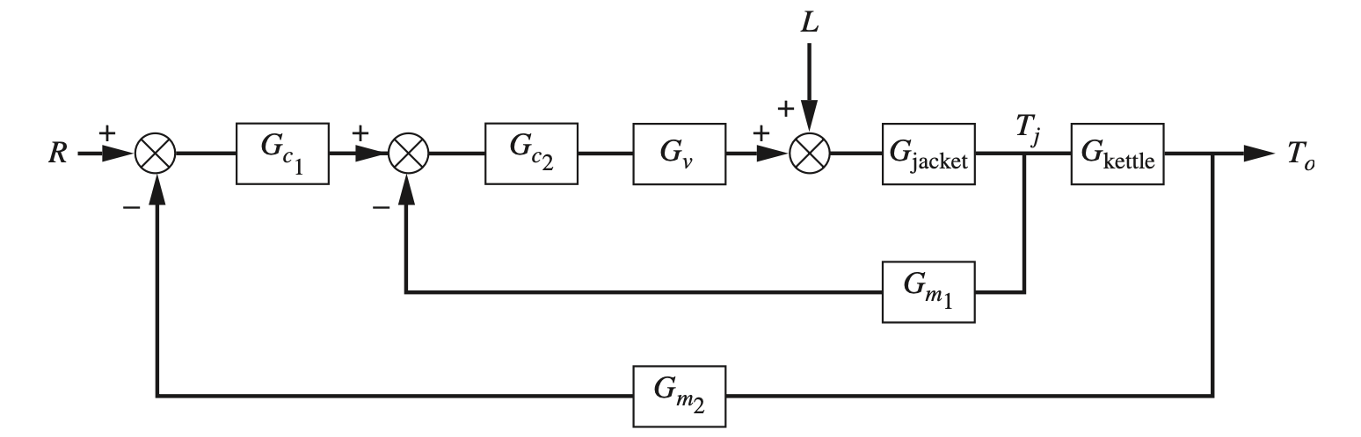
Cascade Control
Jacketed kettle – cascade control
Single loop control of Jacketed kettle – Block diagram

Slide 7
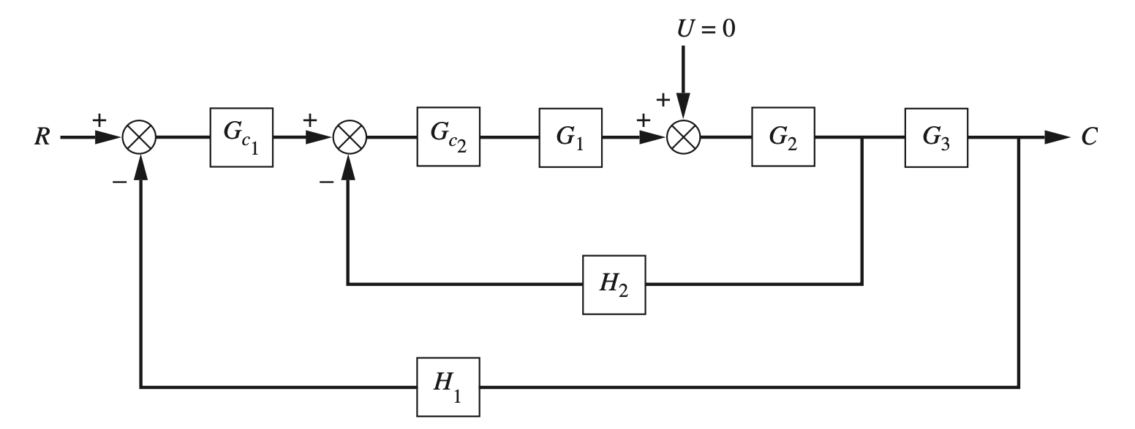
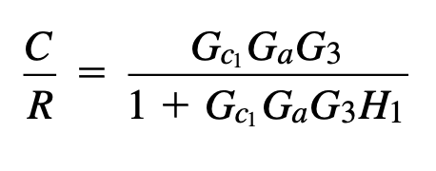
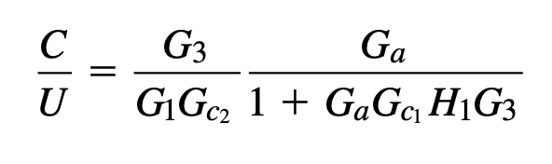
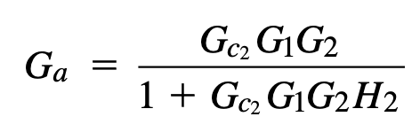
Cascade Control
Analysis of cascade control
Single loop control of Jacketed kettle – General block diagram

Slide 8
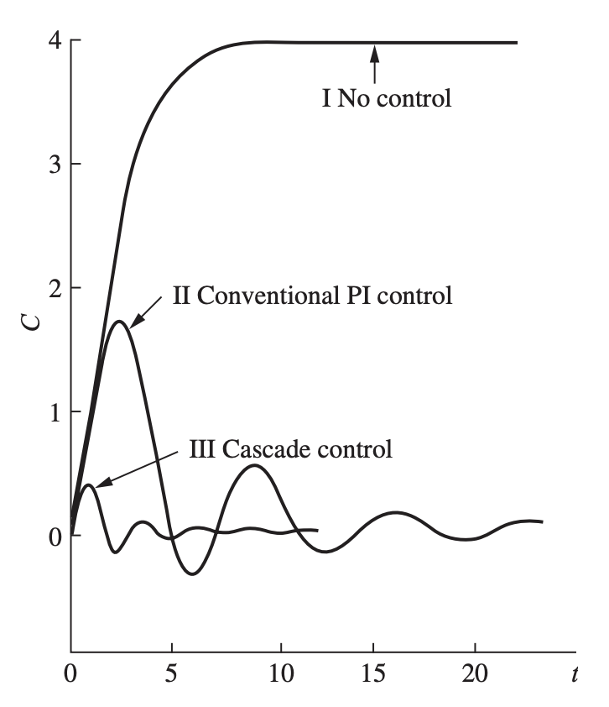
Cascade Control
Analysis of cascade control
Response Comparison

Slide 9
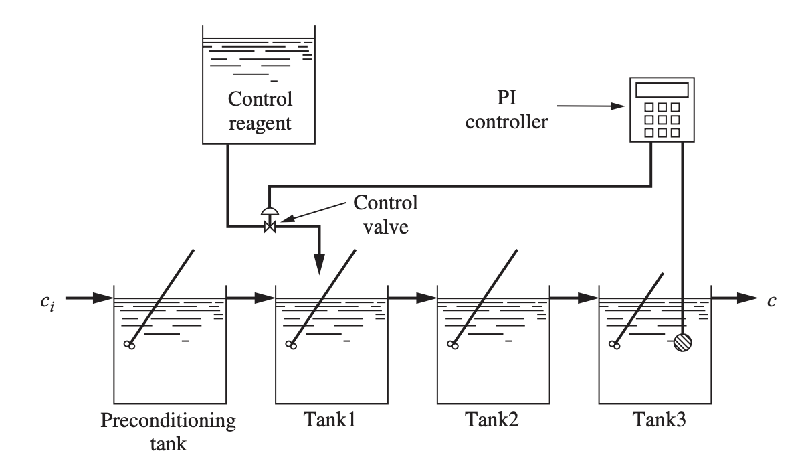
Feedforward Control
Composition Control System as example
Feedforward control useful for managing frequent load disturbances
Outlet concentration to be controlled with inlet from a reagent tank and inlet c_{i}.
For feedback control – information about concentration change reaches controller after passing through all the tanks
Feedback Control for composition control system

Slide 10
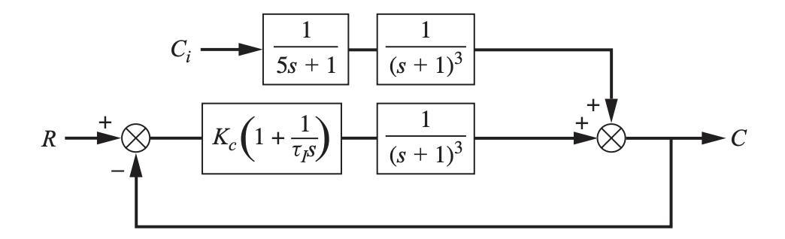
Feedforward Control
Composition Control System as example
Feedback Control for composition control system
Feedback Control Block Diagram

Slide 11
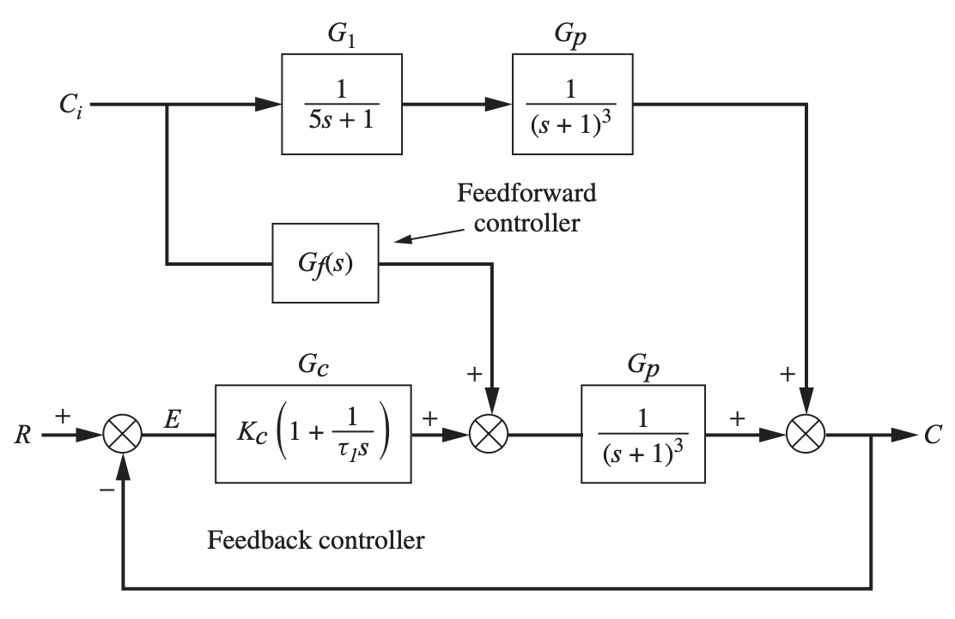
Feedforward Control
Composition Control System as example
Feedback Control Block Diagram
Feedforward Control Block Diagram
A controller that uses information fed forward from the source of the load disturbance is called a feedforward controller

Slide 12

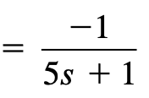
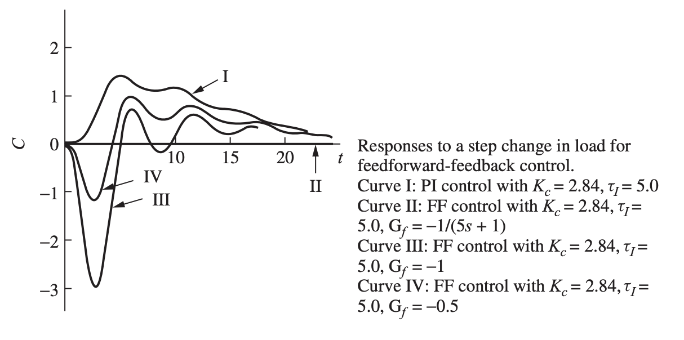
Feedforward Control
Composition Control System - Analysis
Feedforward Control Block Diagram

Slide 13
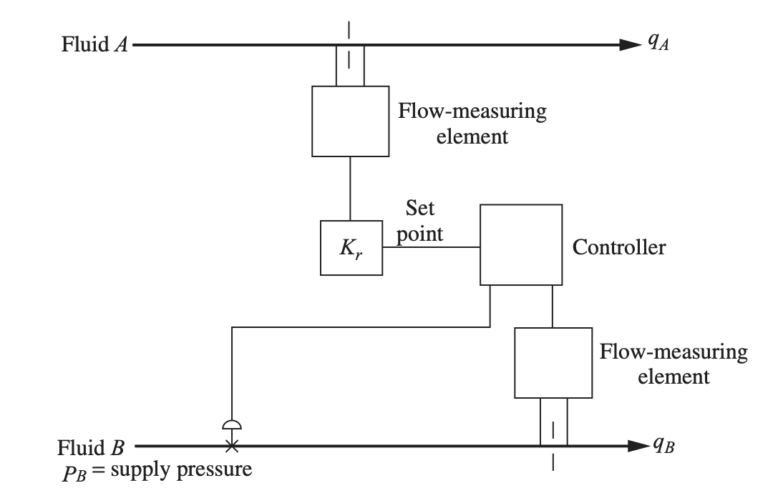
Ratio Control
Blending two liquid streams
Controlling the ratio of fluids A and B is desired
Fluid A is not disturbed – only its flow rate measured
Fluid B – flow rate is controlled and measured
The factor K_{r} determines the ratio between A and B – ultimately controlled using the controller
Ratio Control System

Slide 14
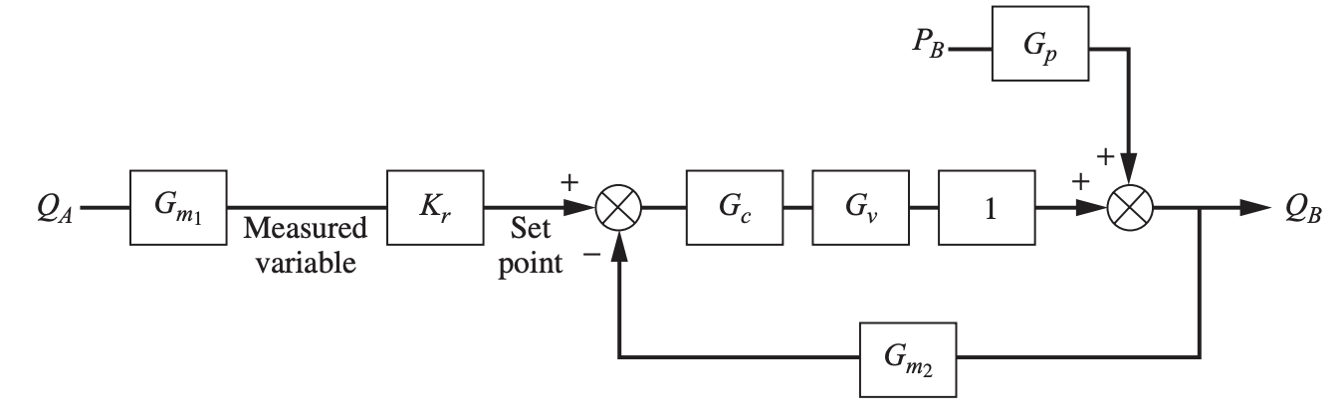
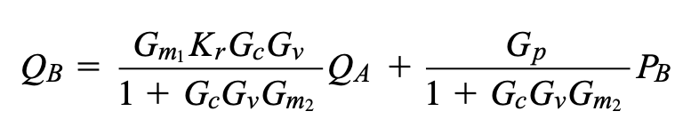
Ratio Control
Blending two liquid streams
Ratio Control System Block Diagram
Ratio Control System

